Slide 1
BLM1612 - Circuit Theory
Prof. Dr. Nizamettin AYDIN
naydin@yildiz.edu.tr
Voltage Division
Voltage Division
Series Resistors
Parallel Resistors
Wye and Delta Networks

Slide 2
Objectives of the Lecture
Explain mathematically how resistors in series are combined and their equivalent resistance.
Explain mathematically how resistors in parallel are combined and their equivalent resistance.
Rewrite the equations for conductances.
Explain mathematically how a voltage that is applied to resistors in series is distributed among the resistors.
Explain mathematically how a current that enters the a node shared by resistors in parallel is distributed among the resistors.
Describe the equations that relate the resistances in a Wye (Y) and Delta (Δ) resistor network.
Describe a bridge circuit in terms of wye and delta sub-circuits.

Slide 3
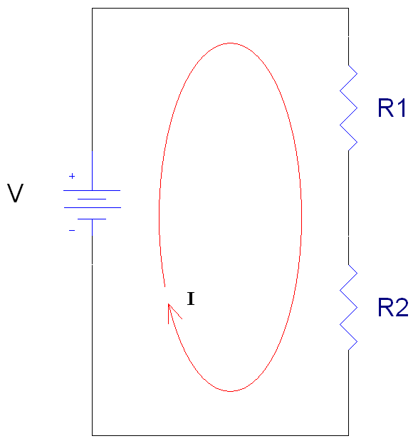
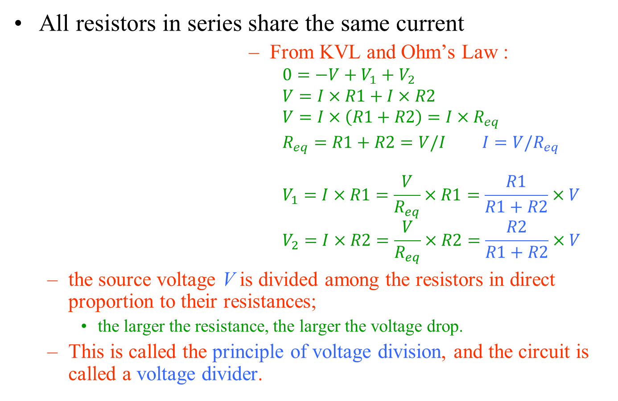
Voltage Division
All resistors in series share the same current
From KVL and Ohm’s Law :
$$0=−V+V_{1}+V_{2}$$
$$V=I×R1+I×R2$$
$$V=I×\left(R1+R2\right)=I×R_{eq}$$
$R_{eq}=R1+R2=V/I$ ${I=V/R}_{eq}$
$$V_{1}=I×R1=\frac{V}{R_{eq}}×R1=\frac{R1}{R1+R2}×V$$
$$V_{2}=I×R2=\frac{V}{R_{eq}}×R2=\frac{R2}{R1+R2}×V$$
the source voltage V is divided among the resistors in direct proportion to their resistances;
the larger the resistance, the larger the voltage drop.
This is called the principle of voltage division, and the circuit is called a voltage divider.
+
V1
-
+
V2
_

Slide 4
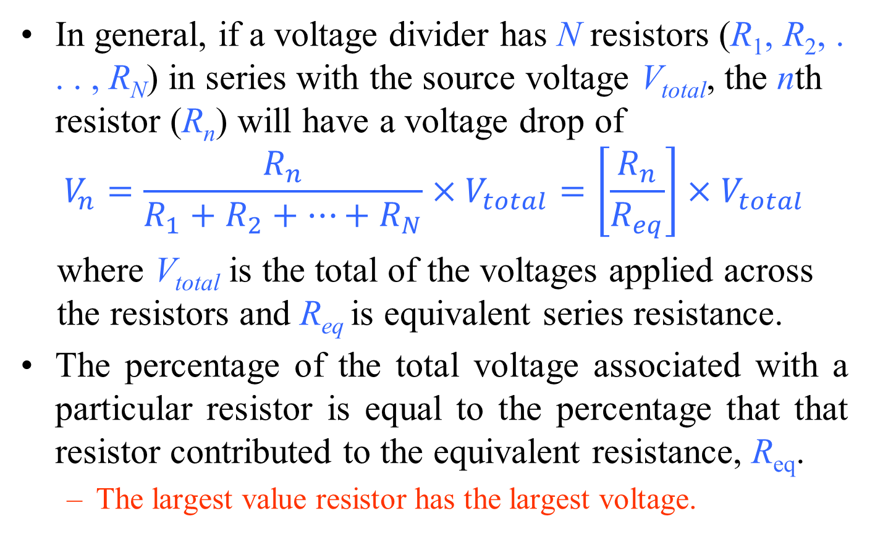
Voltage Division
In general, if a voltage divider has N resistors (R₁, R₂, . . . , R_{N}) in series with the source voltage V_{total}, the nth resistor (R_{n}) will have a voltage drop of
$$V_{n}=\frac{R_{n}}{R_{1}+R_{2}+⋯+R_{N}}×V_{total}=\left[\frac{R_{n}}{R_{eq}}\right]×V_{total}$$
where V_{total} is the total of the voltages applied across the resistors and R_{eq} is equivalent series resistance.
The percentage of the total voltage associated with a particular resistor is equal to the percentage that that resistor contributed to the equivalent resistance, R_{eq}.
The largest value resistor has the largest voltage.

Slide 5
Voltage Division
Using voltmeters to measure the voltages across the resistors
The positive (normally red) lead of the voltmeter is connected to the point of higher potential (positive sign), with the negative (normally black) lead of the voltmeter connected to the point of lower potential (negative sign) for V₁ and V₂.
The result is a positive reading on the display.
If the leads were reversed, the magnitude would remain the same, but a negative sign would appear as shown for V₃.

Slide 6
Voltage Division
Measuring the current throughout the series circuit.
If each ampermeter is to provide a positive reading, the connection must be made such that conventional current enters the positive terminal of the meter and leaves the negative terminal.
The ampermeter to the right of R₃ connected in the reverse manner, resulting in a negative sign for the current.

Slide 7
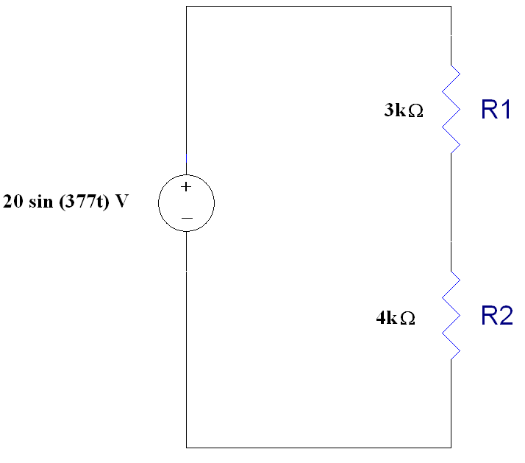
Example 01
Find the V₁, the voltage across R1, and V₂, the voltage across R2
Check: V₁ + V₂ should equal V_{total}
8.57sin(377t) + 11.4sin(377t) = 20sin(377t) V
+
V1
-
+
V2
_

Slide 8
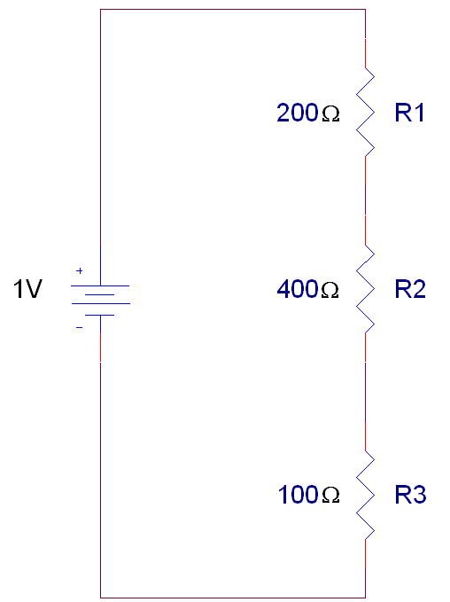
Example 02
Find the voltages listed in the circuit below.
Check: V₁ + V₂ + V₃ = 1V
+
V1
-
+
V2
-
+
V3
-

Slide 9
Example 03
Determine v_{x} in this circuit:
6 Ω || 3 Ω = 2 Ω

Slide 10
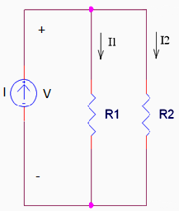
Symbol for Parallel Resistors
To make writing equations simpler, we use a symbol to indicate that a certain set of resistors are in parallel.
Here, we would write
R1║R2
to show that R1 is in parallel with R2.
This also means that we should use the equation for equivalent resistance if this symbol is included in a mathematical equation.

Slide 11
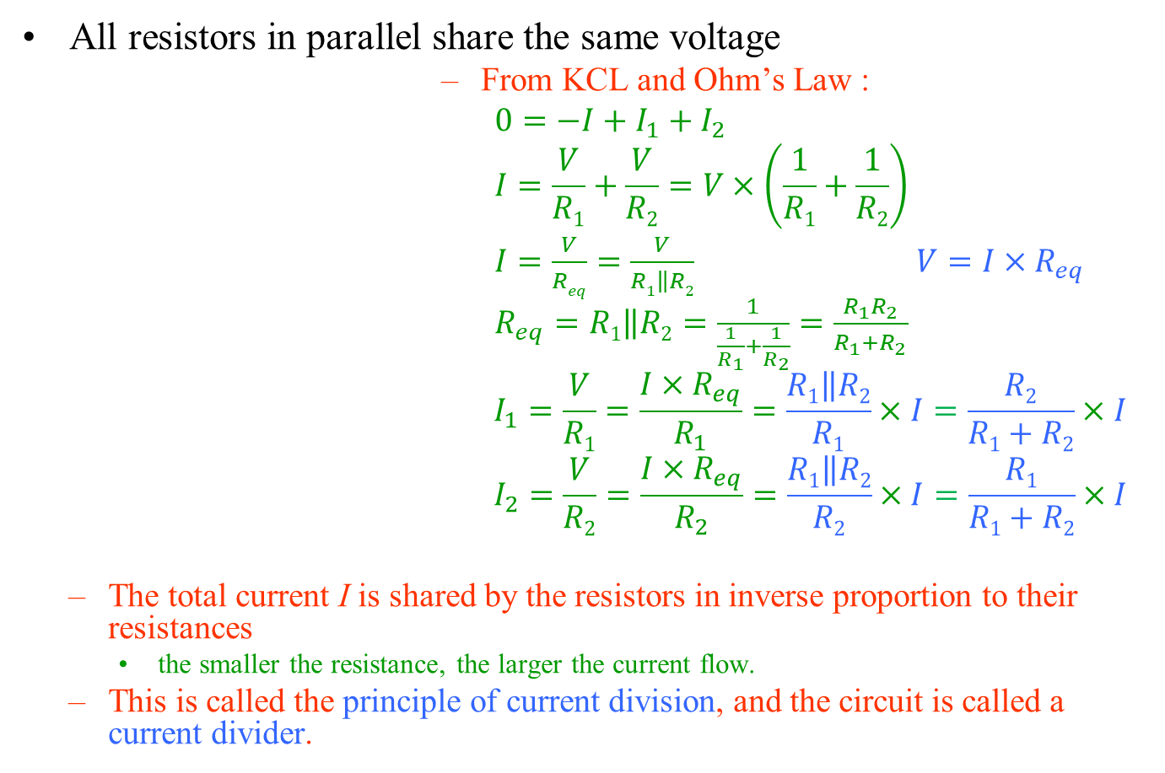
Current Division
All resistors in parallel share the same voltage
From KCL and Ohm’s Law :
$0=−I+I_{1}+I_{2}$
$$I=\frac{V}{R1}+\frac{V}{R2}=V×\left(\frac{1}{R1}+\frac{1}{R2}\right)$$
$I=\frac{V}{Req}=\frac{V}{R1\left\|R2\right.}$ ${V=I×R}_{eq}$
$R_{eq}=R1\left\|R2\right.=\frac{1}{\frac{1}{R_{1}}+\frac{1}{R_{2}}}=\frac{R_{1}R_{2}}{R_{1}{+R}_{2}}$
$$I_{1}=\frac{V}{R1}=\frac{{I×R}_{eq}}{R_{1}}=\frac{R1\left\|R2\right.}{R1}×I=\frac{R2}{R1+R2}×I$$
$$I_{2}=\frac{V}{R2}=\frac{{I×R}_{eq}}{R_{2}}=\frac{R1\left\|R2\right.}{R2}×I=\frac{R1}{R1+R2}×I$$
The total current I is shared by the resistors in inverse proportion to their resistances
the smaller the resistance, the larger the current flow.
This is called the principle of current division, and the circuit is called a current divider.

Slide 12
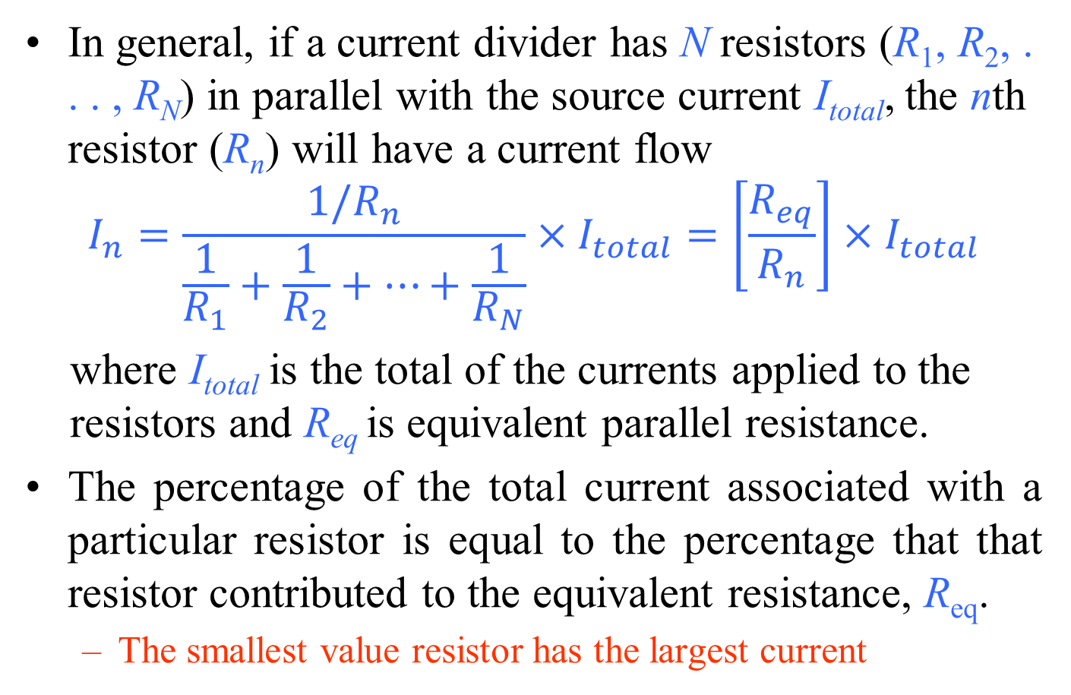
Current Division
In general, if a current divider has N resistors (R₁, R₂, . . . , R_{N}) in parallel with the source current I_{total}, the nth resistor (R_{n}) will have a current flow
$$I_{n}=\frac{{1/R}_{n}}{\frac{1}{R_{1}}+\frac{1}{R_{2}}+⋯+\frac{1}{R_{N}}}×I_{total}=\left[\frac{R_{eq}}{R_{n}}\right]×I_{total}$$
where I_{total} is the total of the currents applied to the resistors and R_{eq} is equivalent parallel resistance.
The percentage of the total current associated with a particular resistor is equal to the percentage that that resistor contributed to the equivalent resistance, R_{eq}.
The smallest value resistor has the largest current

Slide 13
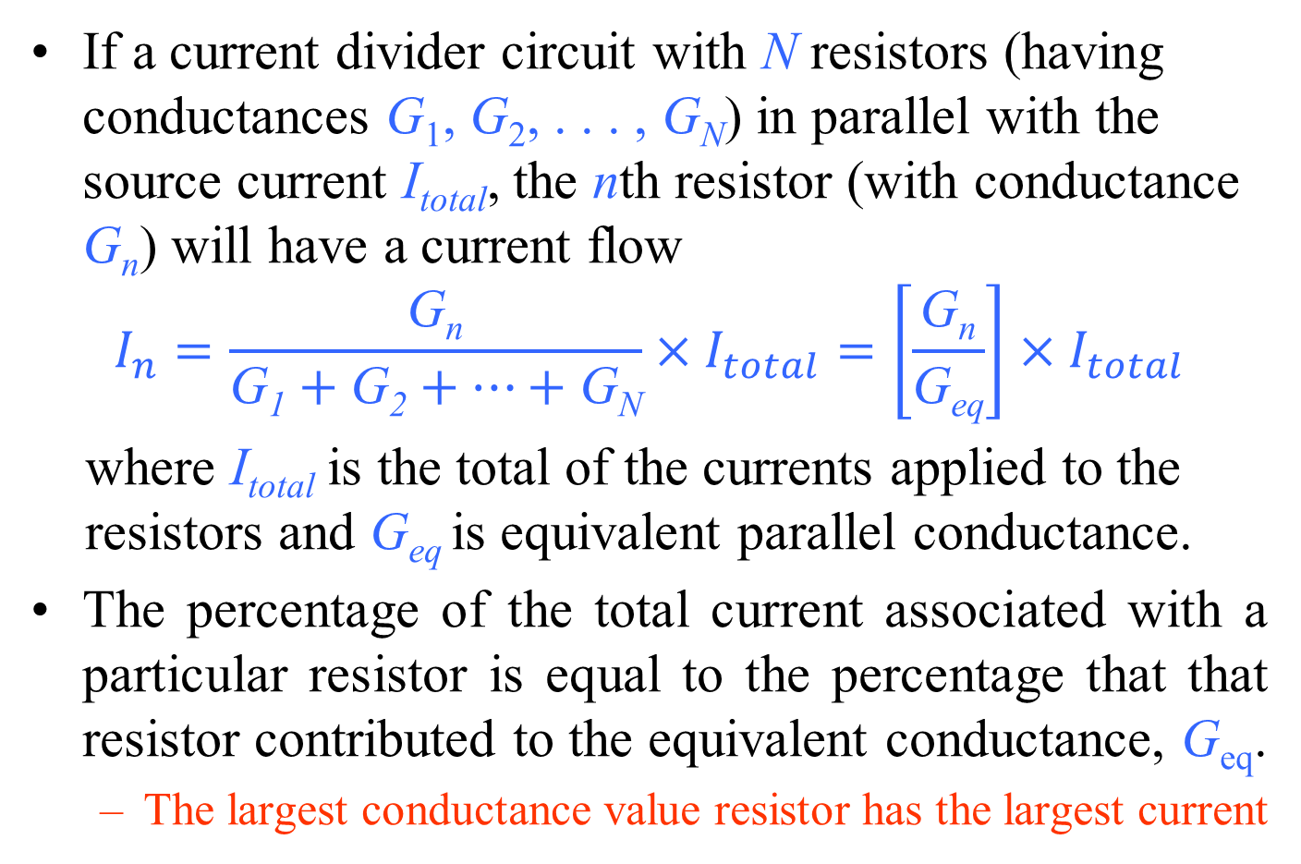
Current Division
If a current divider circuit with N resistors (having conductances G₁, G₂, . . . , G_{N}) in parallel with the source current I_{total}, the nth resistor (with conductance G_{n}) will have a current flow
$$I_{n}=\frac{\text{G}\text{n}}{\text{G}\text{1}+\text{G}\text{2}+⋯+\text{G}\text{N}}×I_{total}=\left[\frac{\text{G}\text{n}}{\text{G}\text{eq}}\right]×I_{total}$$
where I_{total} is the total of the currents applied to the resistors and G_{eq} is equivalent parallel conductance.
The percentage of the total current associated with a particular resistor is equal to the percentage that that resistor contributed to the equivalent conductance, G_{eq}.
The largest conductance value resistor has the largest current

Slide 14
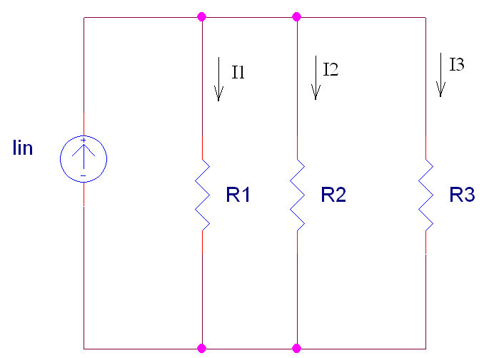
Current Division
For three resistors parallel circuit, current in branches:
Alternatively, you can reduce the number of resistors in parallel from 3 to 2 using an equivalent resistor.
If you want to solve for current I₁, then find an equivalent resistor for R₂ in parallel with R₃.
+
V
_

Slide 15
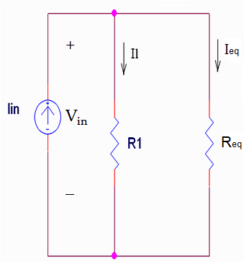
Current Division
+
V_{in}
_

Slide 16
Current Division
The current associated with one resistor R₁ in parallel with one other resistor is:
The current associated with one resistor R_{m} in parallel with two or more resistors is:
where I_{total} is the total of the currents entering the node shared by the resistors in parallel.

Slide 17
Resistors in Parallel
Measuring the voltages of a parallel dc network
Note that the positive or red lead of each voltmeter is connected to the high (positive) side of the voltage across each resistor to obtain a positive reading.

Slide 18
Resistors in Parallel
Measuring the source current of a parallel network
The red or positive lead of the meter is connected so that the source current enters that lead and leaves the negative or black lead to ensure a positive reading.

Slide 19
Resistors in Parallel
Measuring the current through resistor R₁
resistor R₁ must be disconnected from the upper connection point to establish an open circuit.
The ampermeter is then inserted between the resulting terminals so that the current enters the positive or red terminal

Slide 20
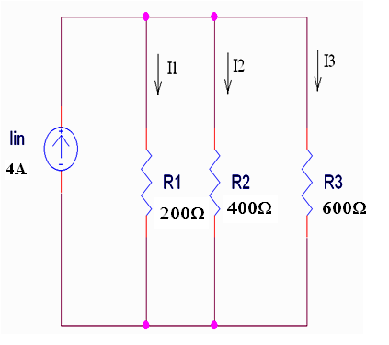
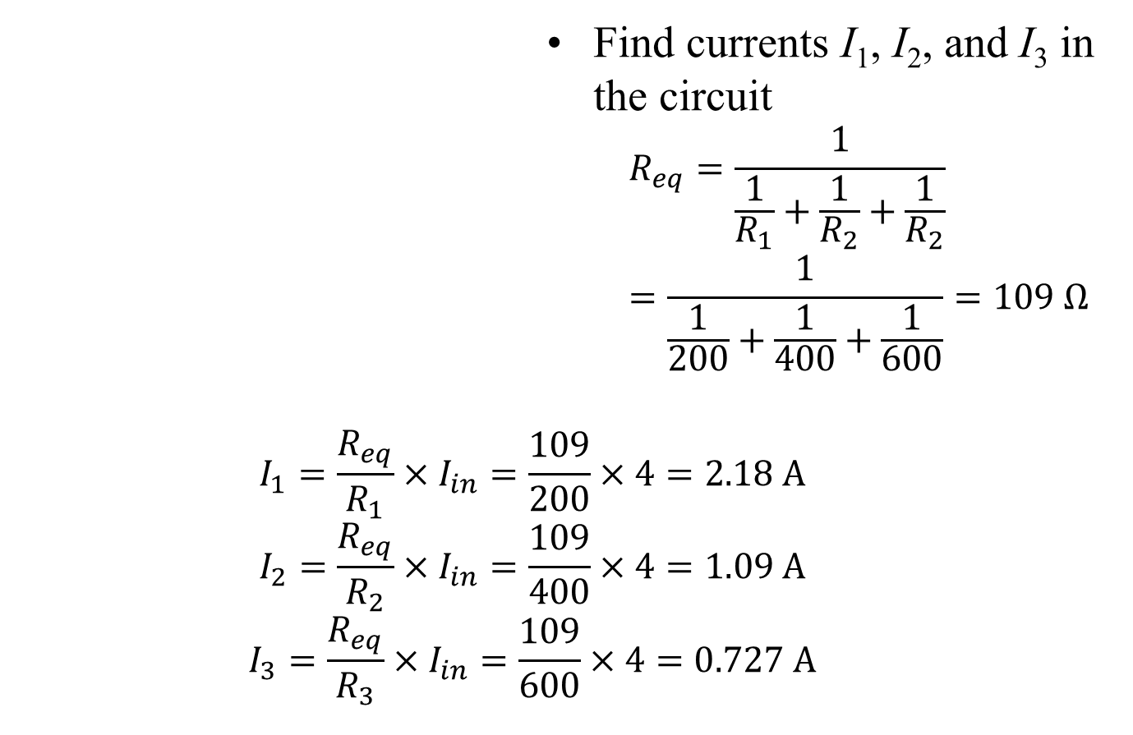
Example 04
Find currents I₁, I₂, and I₃ in the circuit
$$R_{eq}=\frac{1}{\frac{1}{R_{1}}+\frac{1}{R_{2}}+\frac{1}{R_{2}}}=\frac{1}{\frac{1}{200}+\frac{1}{400}+\frac{1}{600}}=109 Ω$$
$$I_{1}=\frac{R_{eq}}{R_{1}}×I_{in}=\frac{109}{200}×4=2.18 A$$
$$I_{2}=\frac{R_{eq}}{R_{2}}×I_{in}=\frac{109}{400}×4=1.09 A$$
$$I_{3}=\frac{R_{eq}}{R_{3}}×I_{in}=\frac{109}{600}×4=0.727 A$$

Slide 21
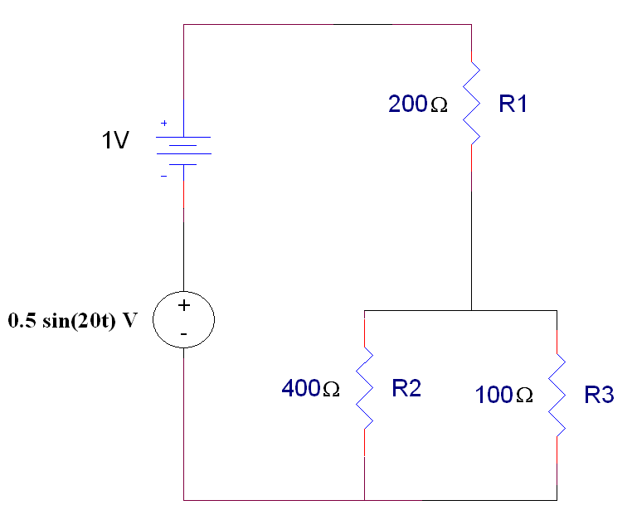
Example 05…
The circuit to the right has a series and parallel combination of resistors plus two voltage sources.
Find V1 and Vp
Find I1, I2, and I3
I1
+
V1
_
I2
I3
+
Vp
_

Slide 22
...Example 05…
I1
First, calculate the total voltage applied to the network of resistors.
This is the addition of two voltage sources in series.
+
V1
_
+
Vtotal
_
I2
I3
+
Vp
_

Slide 23
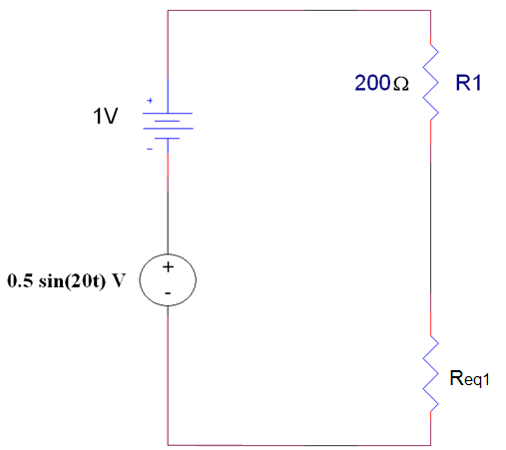
…Example 05…
I1
Second, calculate the equivalent resistor that can be used to replace the parallel combination of R2 and R3.
+
V1
_
+
Vtotal
_
+
Vp
_

Slide 24
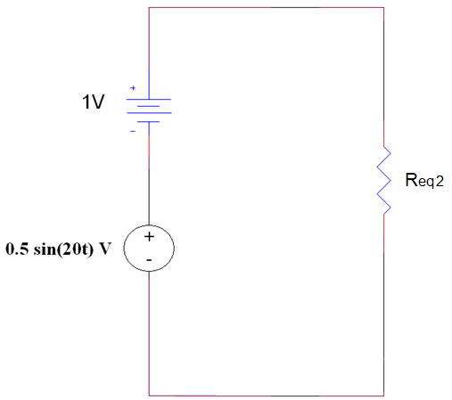
…Example 05…
To calculate the value for I1, replace the series combination of R1 and Req1 with another equivalent resistor.
I1
+
Vtotal
_

Slide 25
…Example 05…
I1
+
Vtotal
_

Slide 26
…Example 05…
I1
To calculate V1, use one of the previous simplified circuits where R1 is in series with Req1.
+
V1
_
+
Vtotal
_
+
Vp
_

Slide 27
…Example 05…
I1
To calculate Vp:
Note: rounding errors can occur. It is best to carry the calculations out to 5 or 6 significant figures and then reduce this to 3 significant figures when writing the final answer.
+
V1
_
+
Vtotal
_
+
Vp
_

Slide 28
…Example 05…
I1
Finally, use the original circuit to find I2 and I3.
+
V1
_
I2
I3
+
Vp
_

Slide 29
...Example 05
I1
Lastly, the calculation for I3.
+
V1
_
I2
I3
+
Vp
_

Slide 30
Summary
The equations used to calculate the voltage across a specific resistor R_{n} in a set of resistors in series are:
The equations used to calculate the current flowing through a specific resistor R_{m} in a set of resistors in parallel are:

Slide 31
Summary Table

Slide 32
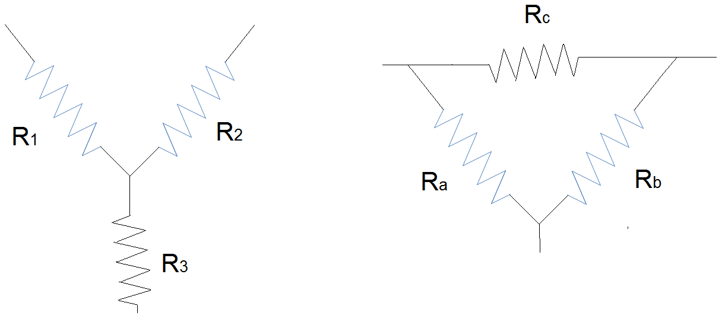
Wye and Delta Networks
3 terminal arrangements – commonly used in power systems
Wye (Y)
Delta (Δ)

Slide 33
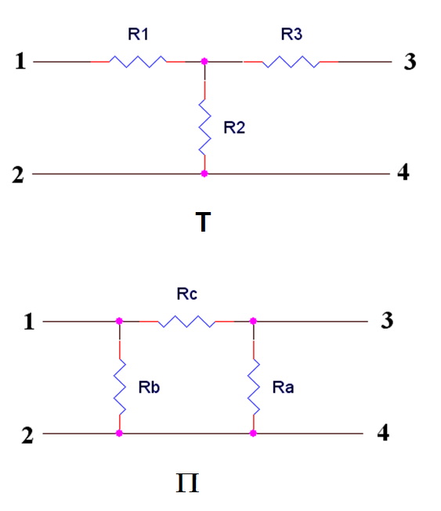
T and Π
Drawn as a 4 terminal arrangement of components.

Slide 34
T and Π
2 of the terminals are connects at one node. The node is a distributed node in the case of the Π network.

Slide 35
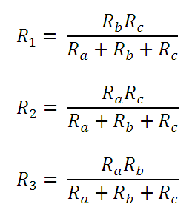
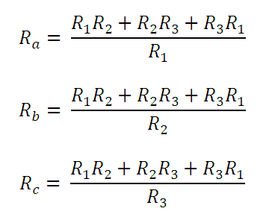
Wye and Delta Networks
To transform a Delta into a Wye
To transform a Wye into a Delta
If R₁ = R₂ = R₃ = R, then Ra = Rb =Rc = 3R
If R_{a} = R_{b} = R_{c} = R’, then R₁ = R₂ = R₃ = R’/3

Slide 36
Uses
Distribution of 3 phase power
Distribution of power in stators and windings in motors/generators.
Wye windings provide better torque at low rpm and delta windings generates better torque at high rpm.

Slide 37
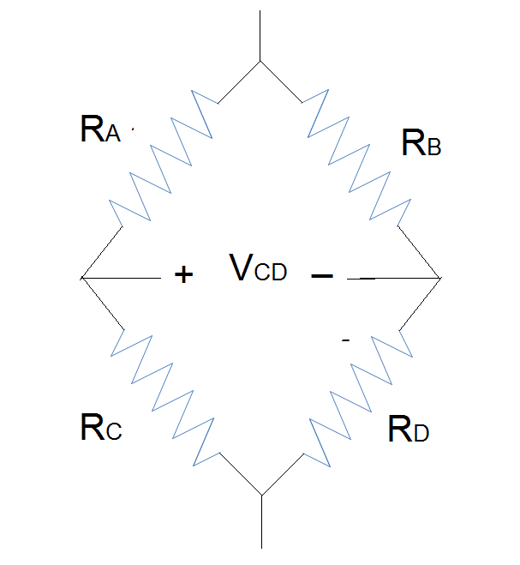
Bridge Circuits
Measurement of the voltage V_{CD} is used in sensing and full-wave rectifier circuits.
If RA = RB = RC = RD, VCD = 0V
In sensing circuits, the resistance of one resistor (usually R_{D}) is proportional to some parameter – temperature, pressure, light, etc. , then VCD becomes a function of that same parameter.

Slide 38
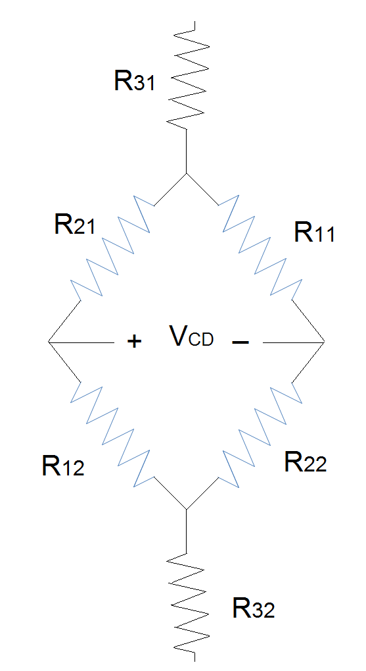
Bridge Circuits
Back-to-back Wye networks

Slide 39
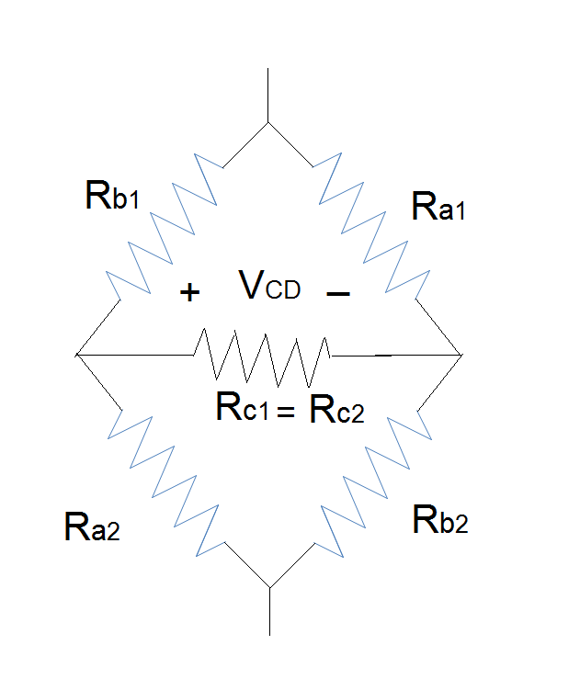
Bridge Circuit
Or two Delta networks where Rc1 = Rc2 = ∞Ω.

Slide 40
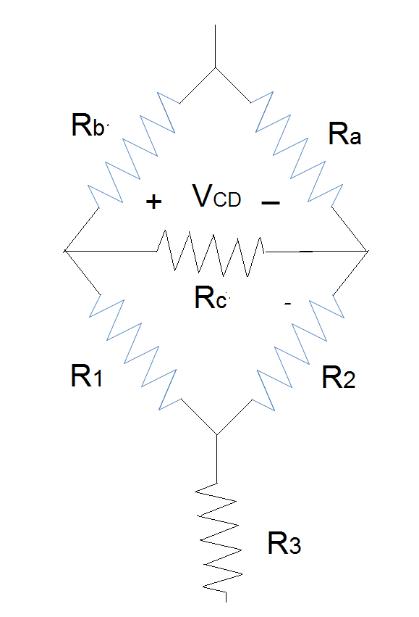
Bridge Circuits
Alternatively, the bridge circuit can be constructed from one Delta and one Wye network where Rc = ∞Ω.

Slide 41
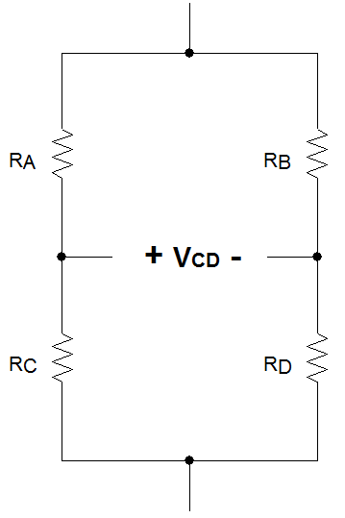
Bridge Circuits
Original circuit redrawn.
VCD = VC – VD
If RA = RB = RC = R and RD = R-δR
+
VT
_
VC
VD

Slide 42
Summary
There is a conversion between the resistances used in wye and delta resistor networks.
Bridge circuits can be considered to be a combination of wye-wye, delta-delta, or delta-wye circuits.
Voltage across a bridge can be related to the change in the resistance of one resistor if the resistance of the other three resistors is constant.

